Slide 1
Domain 4 - Refactoring

Slide 2
Certification Objectives
Optimize application to best use features of AWS
Migrate existing application code to run on AWS
Notes:
For information about troubleshooting API request errors
http://docs.aws.amazon.com/AWSEC2/latest/APIReference/query-api-troubleshooting.html.

Slide 3






Automate Environment, Enhance Scalability
Where possible, automate the provisioning, termination, and configuration of resources
Automatically logs action to a change management solution
Anti-pattern
Best practice
Alerts Auto Scaling to automatically launch and configure identical server
App server crashes
Admin manually launches and configures new server
App server crashes
Amazon CloudWatch automatically detects unhealthy instance
Users manually notify admin
Automatically notifies admin
Notes:
AWS offers built-in monitoring and automation tools at virtually every layer of your infrastructure. You can take advantage of these resources to enable that your infrastructure can respond quickly to changes in needs.
Detecting unhealthy resources and launching replacement resources can be automated, and you can even be notified when resources are changed.

Slide 4

Design Services, Not Servers
Leverage the breadth of AWS; don't limit your infrastructure to servers
Anti-pattern
Best practice
Simple applications run on persistent servers
Applications communicate directly with one another
Static web assets are stored locally on instances
Back-end servers handle user authentication and user state storage
Serverless solution is provisioned at the time of need
Message queues handle communication between applications
Static web assets are stored externally, such as on Amazon S3
User authentication and user state storage are handled by AWS
Notes:
Serverless solutions and managed services offered by AWS can solve many needs without you having to provision, configure, and manage any servers.
Solutions such as AWS Lambda, Amazon Simple Queue Service, Amazon DynamoDB, Elastic Load Balancing, Amazon Simple Email Service, and Amazon Cognito can replace server-based solutions at a lower cost with managed solutions, a lower profile, and more performance.

Slide 5

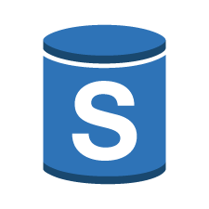
Avoid Single Points of Failure
Best practice
Create a secondary (standby) database server and replicate the data
Replication
Database Server (Primary)
Database Server (Secondary)
Application Server
Secondary server picks up the load
Replication
Database Server (Secondary)
Main database server goes offline
Application Server
Notes:
A common way to solve the problem of a single database server is to create a secondary server (standby) and replicate the data.
If the main database server goes offline, the secondary server picks up the load. Notice that when the main database goes offline, the application servers need to automatically send their requests to the secondary database.

Slide 6



Use Caching
Use caching to minimize redundant data retrieval operations
Anti-pattern
Best practice
Amzaon S3 bucket with data
Caching with CloudFront
Amazon S3 bucket with data
Three requests of equal latency and cost
The 2nd, 3rd, and n^{th} requests are at a lower latency and cost.
Notes:
Caching is the process of temporarily storing data or files in an intermediary location between the requester and the permanent storage for the purpose of making future requests faster and reducing network throughput.
For example, in the anti-pattern in the slide, there is no caching service used by your Amazon S3 bucket.
Three users request a file from one of your Amazon S3 buckets, one at a time.
The file is delivered to each the same way, resulting in each request taking the same amount of time to complete and costing the same amount of money.
Let’s compare that with a better pattern.
In the best practice pattern, your infrastructure has Amazon CloudFront, which offers caching, in front of Amazon S3.
In this scenario, the first request checks for the file in CloudFront. If it doesn’t find it there, it pulls the file from Amazon S3, stores a copy of the file in CloudFront at an edge location closest to the user, and then sends another copy to the user who made the request.
Now, when other users request that file, it's retrieved from the closer edge location in CloudFront, rather than all the way from Amazon S3.
This reduces both latency and cost because, in the requests after the first one, you're no longer paying for the file to be transferred out of Amazon S3.

Slide 7
Sample Question
An application needs to save state information for users. Which AWS Service would be best to use?
An application needs to save state information for users. Which AWS Service would be best to use?
DynamoDB
DynamoDB
Amazon RDS
Amazon RDS
AWS X-Ray
AWS X-Ray
Amazon SNS
Amazon SNS

Slide 8
Sample Question
Which Amazon service can be used for caching? (Choose two answers.)
Which Amazon service can be used for caching? (Choose two answers.)
Amazon S3
Amazon S3
Amazon CloudFront
Amazon CloudFront
Amazon Elasticsearch
Amazon Elasticsearch
Amazon ElastiCache
Amazon ElastiCache

Slide 9
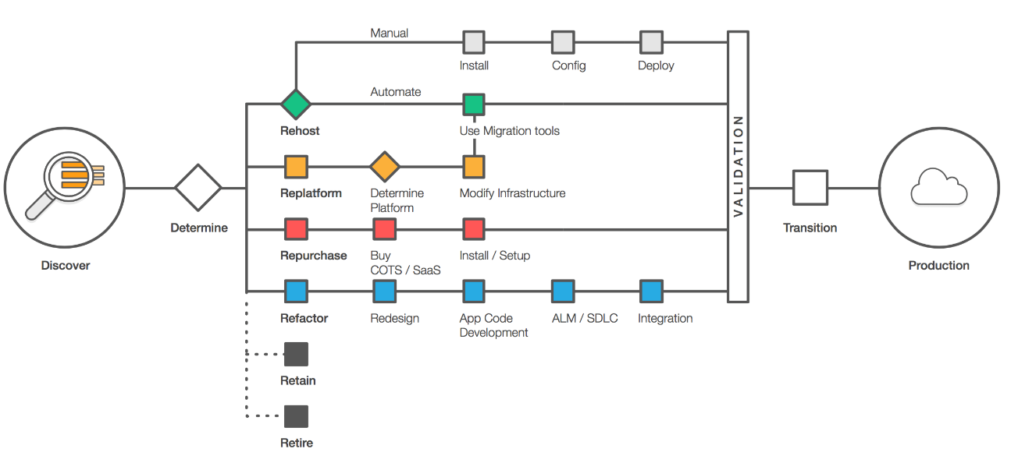
Migration: The 6 R’s
Notes:
To read Six Strategies for Migrating Applications to the Cloud, see
https://medium.com/aws-enterprise-collection/6-strategies-for-migrating-applications-to-the-cloud-eb4e85c412b4.
Migration Strategies
Migrations require both business and IT strategies.
Customers begin the migration process of moving applications to the cloud by combining expertise and resources to implement strategies.
The six strategies are the paths that can be taken to complete a migration.
Gartner’s (Gartner, Inc.) Six R’s of Migration
Rehosting: Lift and Shift
Replatforming: Lift, Tinker, and Shift to re-shape a product or resource
Repurchasing: Drop and Shop or replacing a product or resource
Refactoring or Re-architecting: Recode or re-architect your applications to run on the cloud. Decouple applications and components.
Retire: Retiring a product or resource completely.
Retain: Keeping a legacy product or resource.
For more information
https://aws.amazon.com/cloud-migration/
https://www.gartner.com/newsroom/id/1684114

Slide 10
Refactoring
Rewriting and decoupling applications
Re-architecting a solution
Complete refactor vs. partial refactor
Notes:
Migration takes multiple forms and paths. Refactoring is the rewriting, re-architecting, and decoupling of existing applications.
Refactoring is one of the migration strategies that can be implemented for moving application into the cloud. Moving applications into the cloud following a well-architected framework is not a simple process. Refactoring is one of the options for migrating applications.
Refactoring requires visiting existing application design and performance to implement business processes aligned with cloud concepts for solutions. It includes re-architecting a solution based off of cloud services whether in a hybrid or all-in cloud environment. Examples of these concepts include scalability, availability, flexibility, operations, and performance.
For Refactoring, you can address these types of questions for migration:
Will the design include a multi-tier architecture or service-oriented architecture?
Will the application migration include an implementation of serverless architecture?
Will there be external or traditional components connecting with the services utilized?
How does refactoring help to implement a well-architected framework?
How do I implement an automated ALC or SDLC according to AWS best practices?
How do I integrate my AWS components as an overall solution?
What tools are available for validation and security of applications migrating to the AWS cloud?
How can I assure users of the application will not experience any downtime during transition to the cloud?
How soon can the architecture and application be rapidly deployed and running on a production environment?
For more information
https://aws.amazon.com/blogs/enterprise-strategy/6-strategies-for-migrating-applications-to-the-cloud/.
Next steps include:
Integration
Validation
Transition
Production deployment

Slide 11


Lift and Shift Example: All-In
Monolithic application
File ingestion
File processing
File publishing
AWS cloud
Notes:
Cloud adoption is becoming the new normal for enterprises, which leads to a debate about which approach to take when migrating to the cloud.
It’s usually not difficult to reach a consensus on a cloud first strategy for new capabilities delivered. But, it’s harder to agree on a common approach to the numerous existing applications that still reside in company data centers. Teams responsible for effecting an enterprise’s transition to the cloud might initially find it easier to apply a one-size-fits-all approach, cutting through debates about risks and dependencies. However, that approach could jeopardize the trust and cooperation of the application owners they are asking to migrate.
Many enterprise cloud teams are successful earning this trust and cooperation while delivering on aggressive timelines in lift-and-shift cloud migrations. The goal is to move a specific set of applications to the cloud as fast as possible without changing core architecture, functionality, or performance characteristics. It’s no small challenge since some application development teams will think that their software requires substantial refactoring to run in the cloud. Others don’t want to bring their technical debt to a pristine new cloud environment.
The fundamental notion of software refactoring is to change application code for the better.

Slide 12

Lift and Shift Example: Hybrid
Monolithic application
File ingestion
File processing
File publishing
AWS cloud
Corporate data center
Notes:
At the most fundamental level, hybrid computing can be viewed as having data that resides both on-premises and in the cloud. This often is done to economically store large data sets, utilize new cloud-native databases, move data closer to customers, or to create a backup and archive solution with cost-effective, high availability.
In all cases, AWS offers a range of storage and database services that can work together with your on-premises applications to store data reliably and securely.

Slide 13





Microservices Example
Monolithic application
Microservices
File pulled down for processing
File ingestion
Put message
Ready for processing queue
File processing
File pushed to bucket
File ingestion, processing, and publishing
User subscribed to topic
“Processing complete” message sent to Amazon SNS topic
User given access to published file
Notes:
Traditional monolithic architectures are hard to scale. As an application's code base grows, it becomes complex to update and maintain. Introducing new features, languages, frameworks, and technologies becomes difficult, limiting innovation and new ideas.
Within a microservices architecture, each application component runs as its own service and communicates with other services through a well-defined API. Microservices are built around business capabilities. Each service performs a single function. Microservices are written using different frameworks and programming languages. You can deploy them independently as a single service or as a group of services.

Slide 14

To Serverless
Microservices
File pulled down for processing
File ingestion
Put message
Ready for processing queue
File processing
File pushed to bucket.
User subscribed to topic
"Processing complete" message sent to Amazon SNS topic
User given access to published file
Notes:
Serverless typically refers to serverless applications. Serverless applications don't require you to provision or manage any servers. You can focus on your core product and business logic instead of responsibilities like operating system (OS) access control, OS patching, provisioning, right-sizing, scaling, and availability.
When you build your application on a serverless platform, the platform manages these responsibilities for you.

Slide 15
Sample Question
Which services can assist with refactoring a solution to be a more cost-saving option to an existing, on-premises hosted application? (Choose three answers.)
Which services can assist with refactoring a solution to be a more cost-saving option to an existing, on-premises hosted application? (Choose three answers.)
Amazon S3 static website hosting
Amazon S3 static website hosting
B. Use
B. Use AWS Application Discovery Service to launch your application.
B. Use AWS Application Discovery Service to launch your application.
C. Use EC2 instances to run the application along with an Amazon RDS database.
C. Use EC2 instances to run the application along with an Amazon RDS database.
D. Use Lambda functions and DynamoDB for data.
D. Use Lambda functions and DynamoDB for data.

Slide 16
Test Axioms
Durability and availability are not the same thing
Scalability and elasticity are not the same thing
Migrate your monolith applications to microservices to functions
Go serverless

